Slide 1

22/FA-COP-2939-68831
Capstone Project Presentation
Game Development with GODOT: Abyssal
Created By: Johnathan Webster
Student Number: 1040332
Instructor: Dr. Banisakher
Date: 11/10/2022

Slide 2
Outline
Why a video game?
Personal history with videogames - Passion for computers
What I learned
What we accomplished
Conclusion
References
Questions

Slide 3

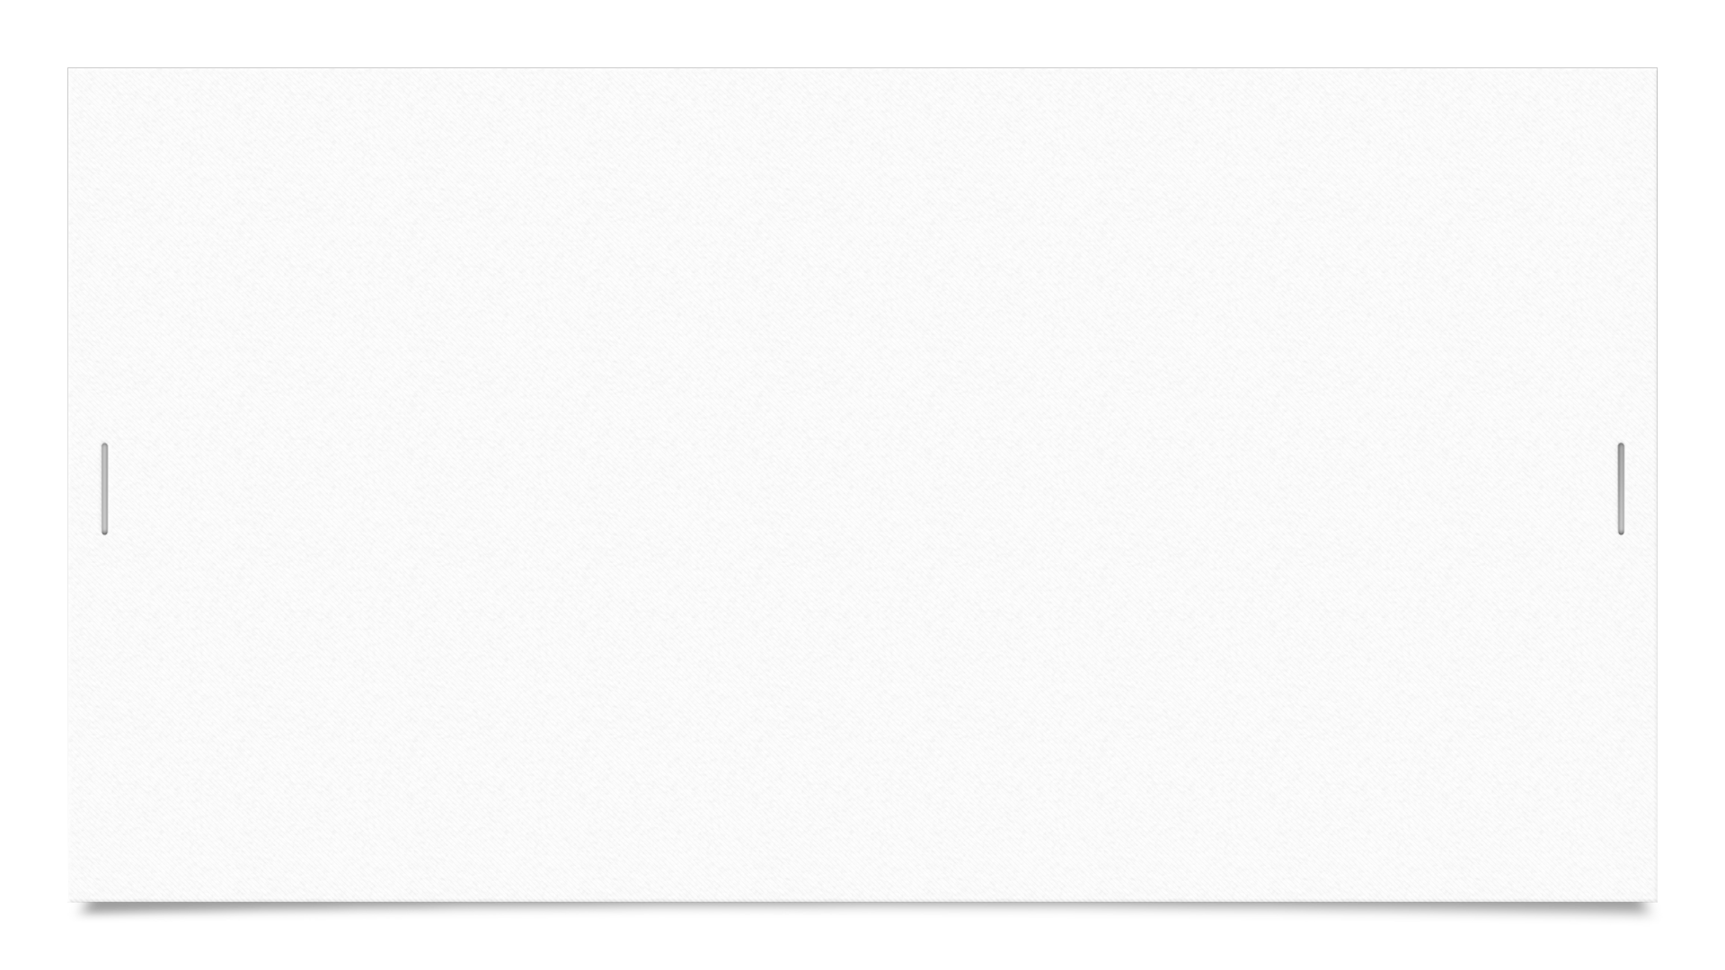
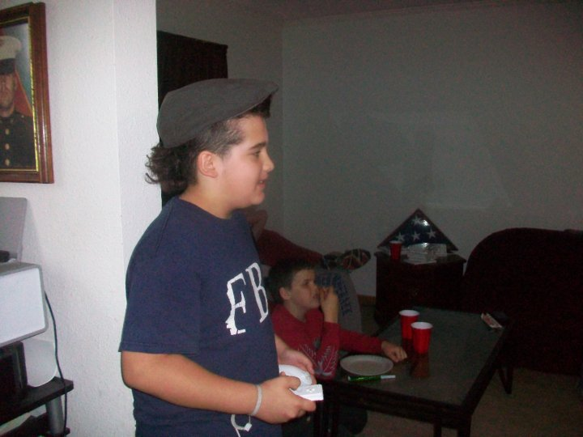

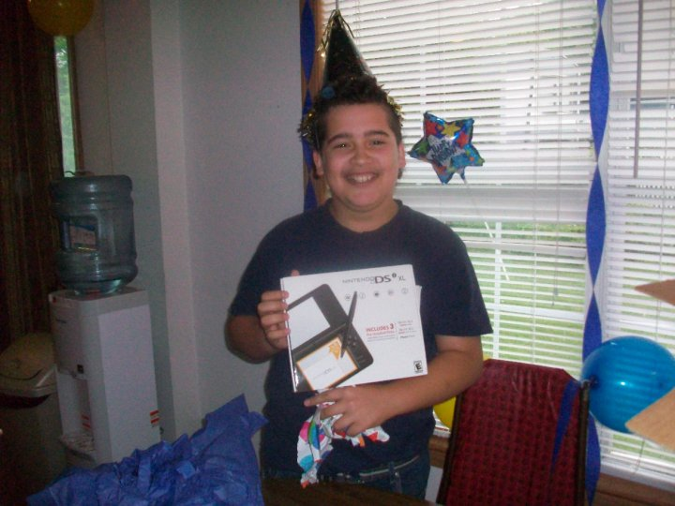
Why a videogame?
I have always had a passion for videogames from an early age
I was always fascinated with computers and technology

Slide 4
What I learned
Development is hard!
You never stop learning
It’s a feature not a bug

Slide 5

What we accomplished

Slide 6
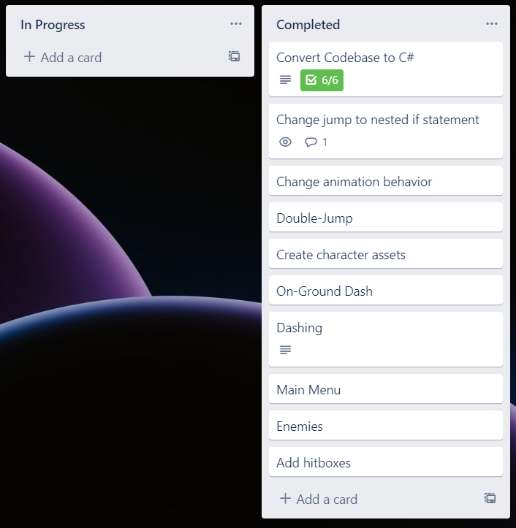
Design
I started with a Trello board to jot down all the features I wanted to add. I then decided to organize them in order of importance and feasibility. I soon realized that I wanted to incorporate so many features I became overwhelmed.
*Example shown is sample from board

Slide 7
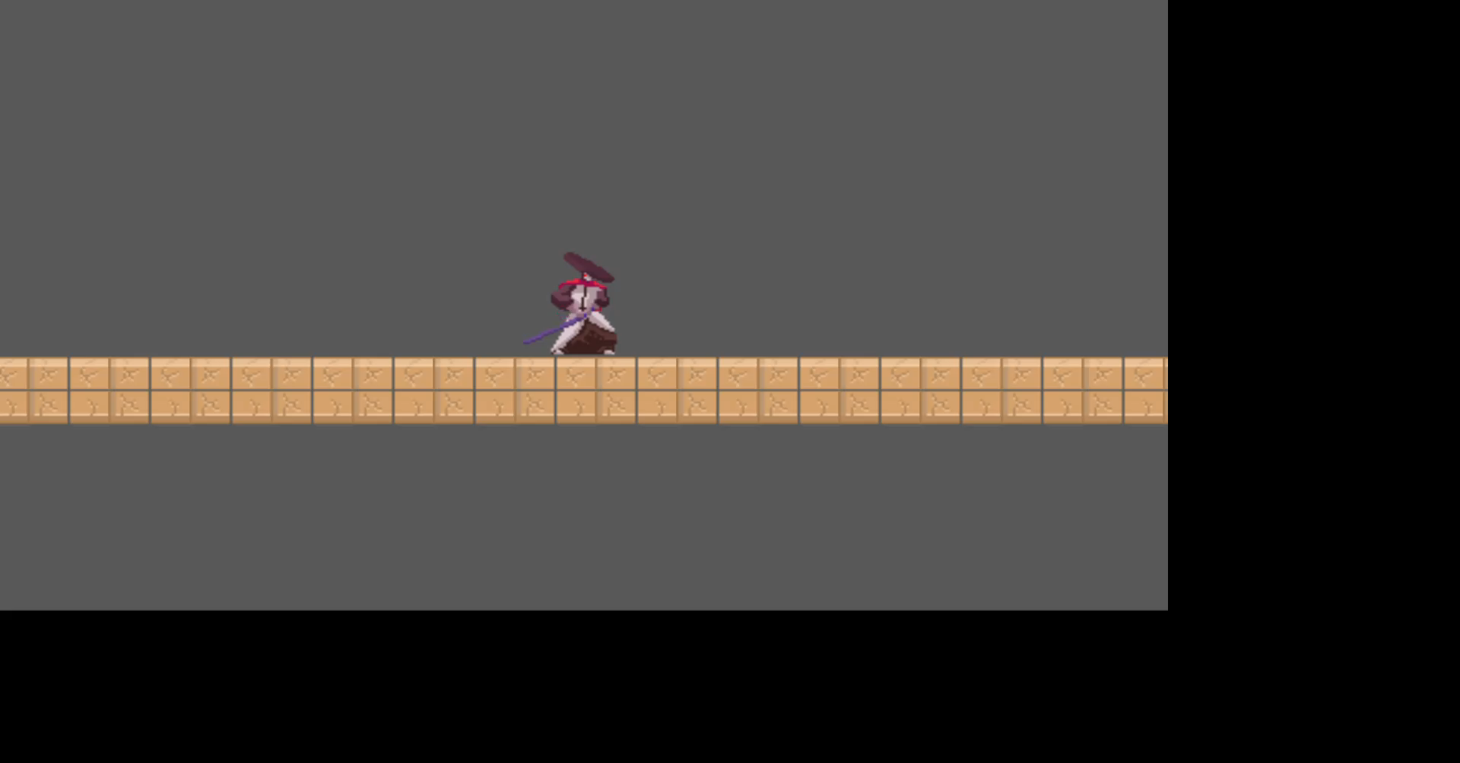
I eventually decided to make a Mario type 2D side scroller. It would encompass similar movement mechanics but would have a slightly different feel.

Slide 8
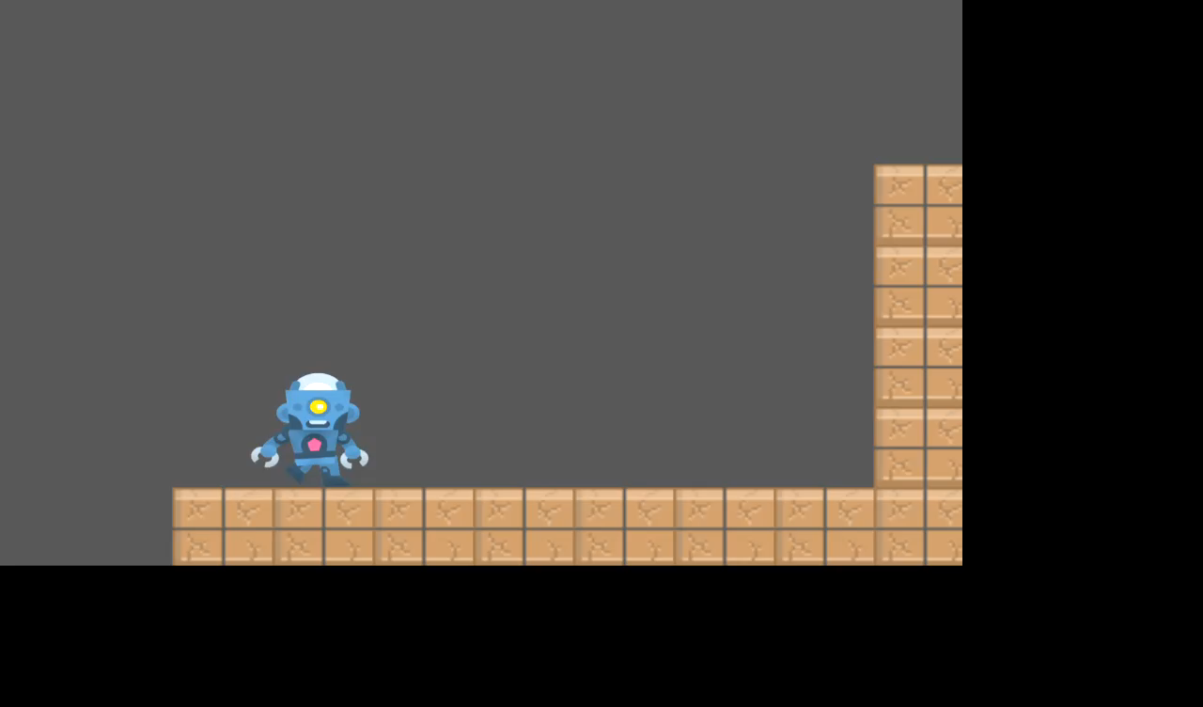
After creating the basic movement of the character, I decided to add an enemy. The enemy uses ray casting to tell if it is touching a wall or if it is about to fall and adjust accordingly.

Slide 9
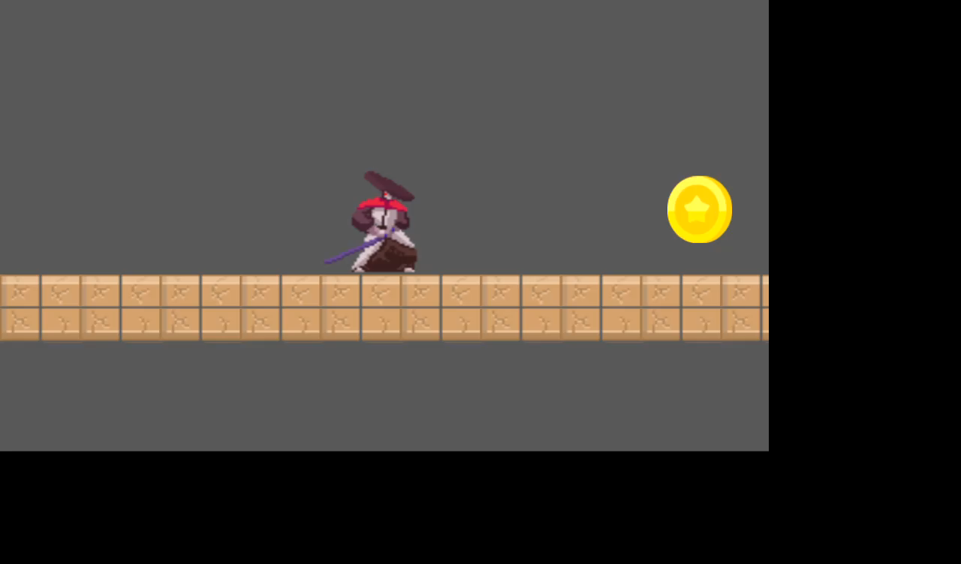
Items naturally came next, and I added a coin that when collided with removes the coin from the scene

Slide 10
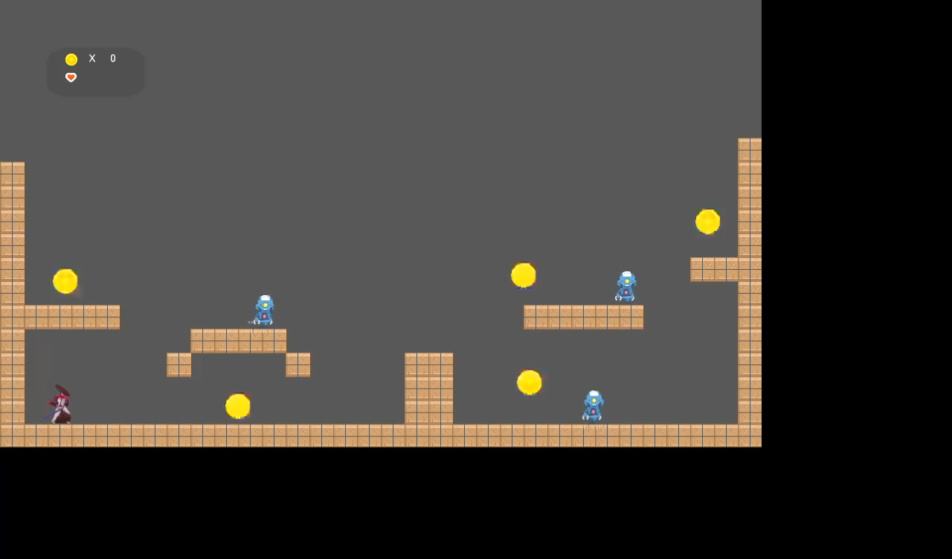
When we combine all these together, we get a scene that resembles that of a platformer

Slide 11
Conclusion
Abyssal was a fun and huge learning experience. This project taught me multiple things from time management, organization, how software programs interact with one another and most importantly to research. The amount of effort put into this simple program is one that I am proud of and truly admire all developers out there who provided all the content and resources I was able to utilize for free. I am proud I was able to deliver most of the original content that was described in the beginning, however, I quickly realized that I was being too ambitious. I was unable to include multiple features I originally planned and had to adjust my test matrix to meet requirements.

Slide 12
References
Godot game engine documentation: https://docs.godotengine.org/en/stable/
Windows Operating System: https://docs.microsoft.com/en-us/windows/
Asset Artist: https://www.kenney.nl/assets
.NET SDK: Framework for Mono Version
Visual Studio Code: For external IDE development
YouTube:
GDQuest
BornCG
FinePointCGI

Slide 13
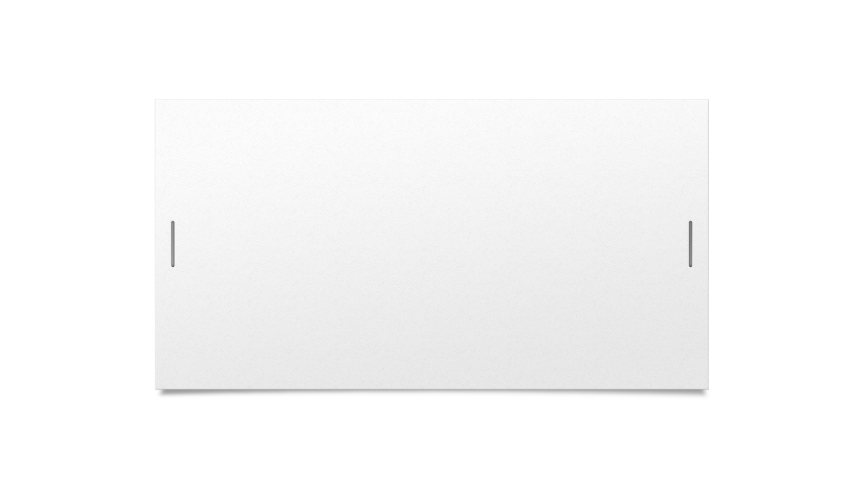
Questions?

